Slide 1
HEART DISEASE PREDICTION USING SEVERAL CLASSIFICATION MODELS
CS 513 - B
KNOWLEDGE DISCOVERY AND DATA MINING

Slide 2


GROUP 4 TEAM MEMBERS
ROUSHAN KUMAR | CWID: 20009314
ISHAN ARYENDU | CWID : 10474734
SABAH AHMED | CWID : 10478272
ZHU LI | CWID : 10454296

Slide 3
INTRODUCTION AND PROBLEM OVERVIEW
12 million deaths occur worldwide, every year due to Heart diseases.
Half of the deaths in the United States and other developed countries are due to cardiovascular diseases.
Early prognosis of cardiovascular diseases can aid in making decisions on lifestyle changes in high-risk patients and in turn reduce complications.

Slide 4
GOAL & OBJECTIVE
Our classification goal is to determine whether the patient has a 10-year risk of developing/future coronary heart disease (CHD) using several Machine Learning/Data Mining methods from an ongoing cardiovascular study on people of Framingham, Massachusetts.
Build a predictive model that predicts the patient has a 10-year risk of future coronary heart disease (CHD) or not based on their potential risk factor/ patients’ information and compare the ML models
Predict and Classify what predictors/features might be of importance for the risk of CHD.

Slide 5
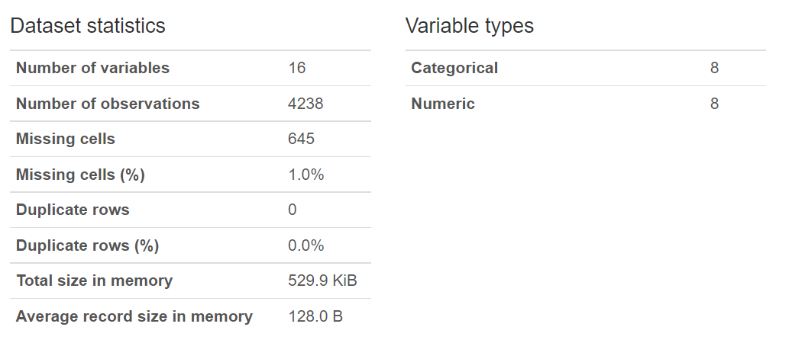
ABOUT THE DATASET
Data Source References: https://www.kaggle.com/datasets/dileep070/heart-disease-prediction-using-logistic-regression

Slide 6
DATA FIELDS
The dataset provides the patients’ information
Each attribute is a potential risk factor. There are both demographic, behavioral and medical risk factors.
Demographic | Behavioral | Medical( history) | Medical(current)
Male: Whether the patient is male or female | Current Smoker: whether or not the patient is a current smoker | BP Meds: whether or not the patient was on blood pressure medication | Tot Chol: total cholesterol level
Age: Age of the patient | Cigs Per Day: the number of cigarettes that the person smoked on average in one day | Prevalent Stroke: whether or not the patient had previously had a stroke | Sys BP: systolic blood pressure
Education: 1- Primary education 2- Secondary education 3- Postsecondary education 4- Graduate and above |  | Prevalent Hyp: whether or not the patient was hypertensive | Dia BP: diastolic blood pressure
 |  | Diabetes: whether or not the patient had diabetes | BMI: Body Mass Index
 |  |  | Heart Rate: heart rate
 |  |  | Glucose: glucose level
Predict variable (desired target) : 10 year risk of coronary heart disease CHD (binary: “1”, means “Yes”, “0” means “No”)

Slide 7
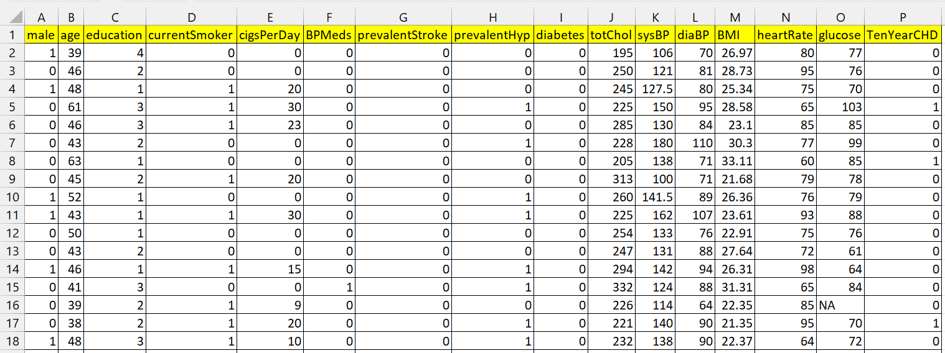
ORIGINAL DATASET

Slide 8
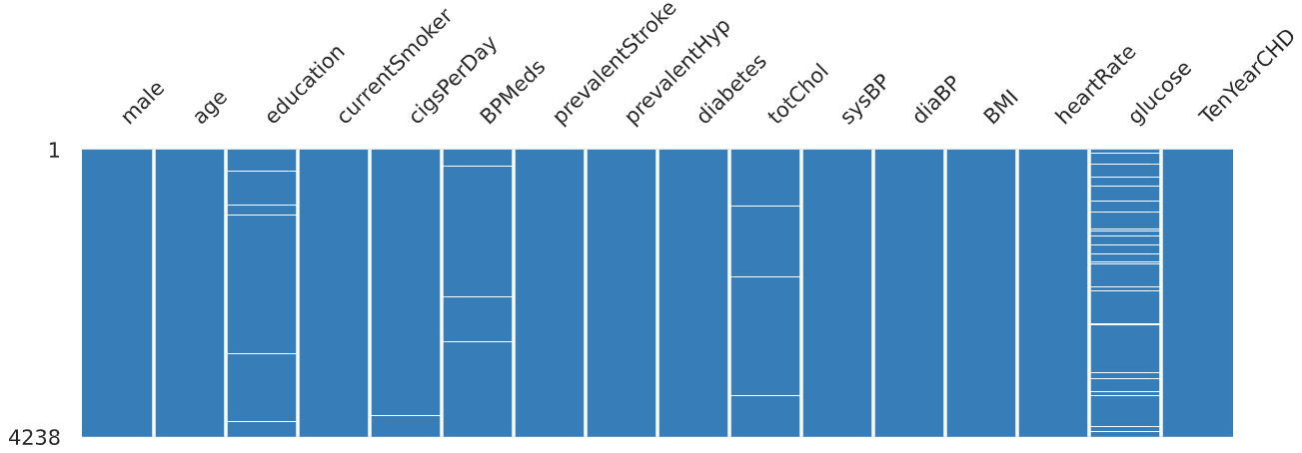
MISSING VALUES USING NULLITY MATRIX

Slide 9
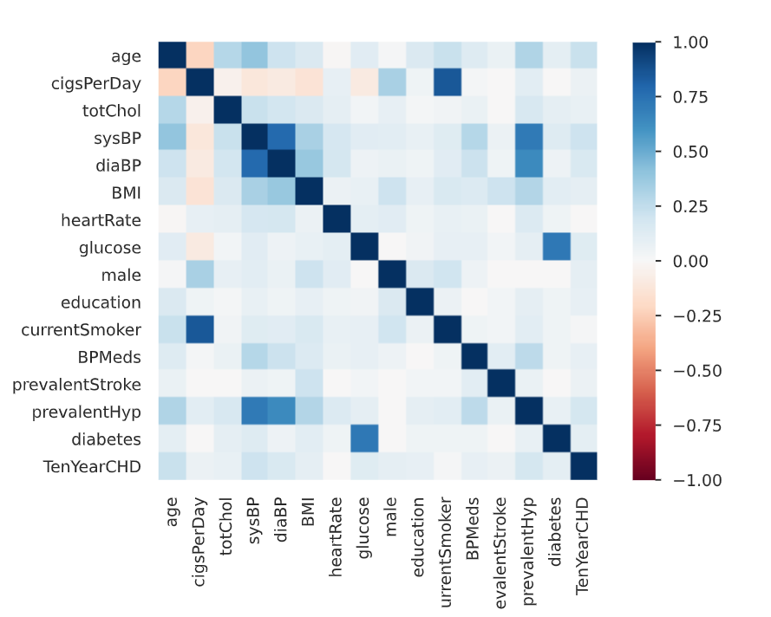
CORRELATIONS HEATMAP

Slide 10
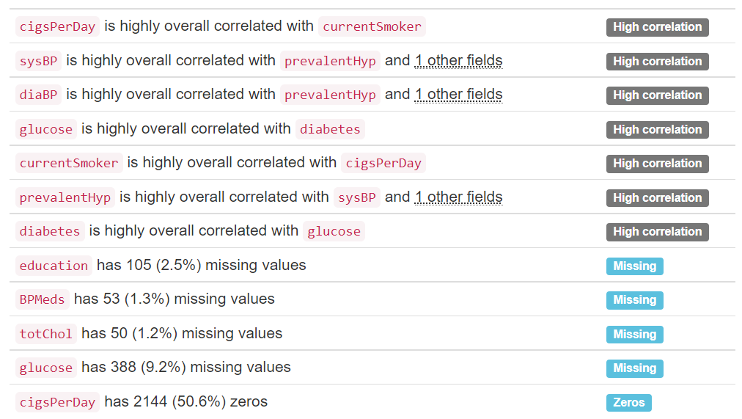
ALERTS ON FEATURES

Slide 11
PREPROCESSING
The feature prevalentHyp was removed from the training and testing datasets because it had a high correlation with the sysBP and diaBP feature
Because currentSmoker had a strong correlation with the cigsPerDay feature, they were taken out of the training and testing datasets.
The missing values were replaced with the mode of the feature set and min-max scaler was used to normalize the rest of the features in the dataset.
The dataset contained bias. So, to balance the training dataset we used SMOTETomek.

Slide 12
MODEL BUILDING
We used the features [ 'male', 'age', 'education', 'cigsPerDay', 'BPMeds', 'prevalentStroke', 'diabetes', 'totChol', 'sysBP', 'diaBP', 'BMI', 'heartRate', 'glucose', 'TenYearCHD'] for training the model.
Our target feature is 'TenYearCHD'.
The training and testing datasets were divided 80:20 from the normalized and imputed data.
We used k-fold cross validation to validate the model against the validation dataset.

Slide 13
CLASSIFICATION ALGORITHMS
 | Logistic Regression Naive Bayes Random Forest Extreme Gradient Boost KNeighbors Decision Tree Support Vector Classifier

Slide 14
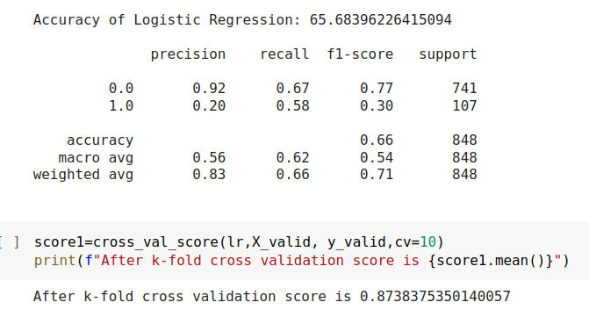
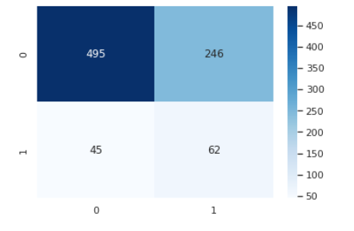
LOGISTIC REGRESSION
Confusion Matrix

Slide 15
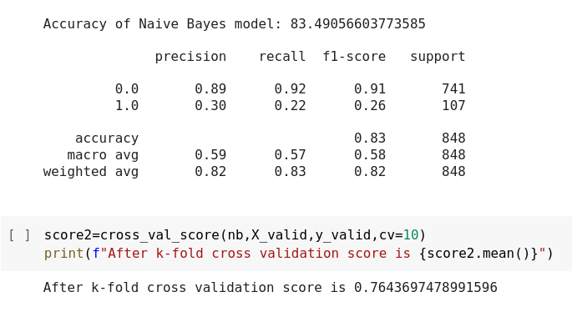
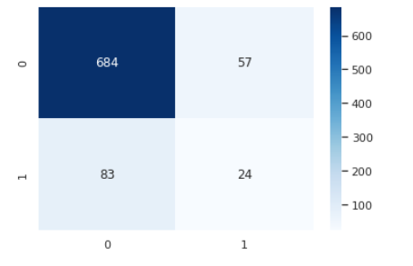
NAIVE BAYES
Confusion Matrix

Slide 16
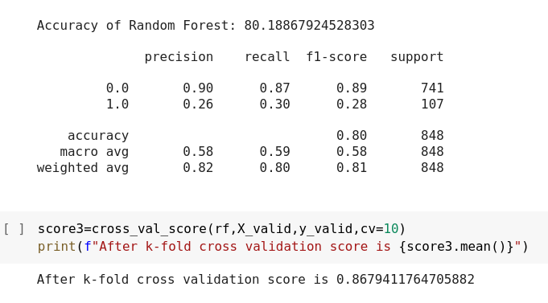
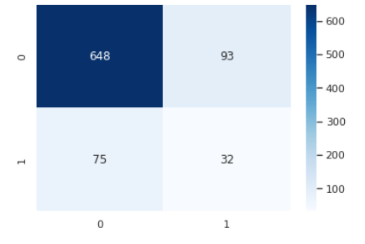
RANDOM FOREST
Confusion Matrix

Slide 17
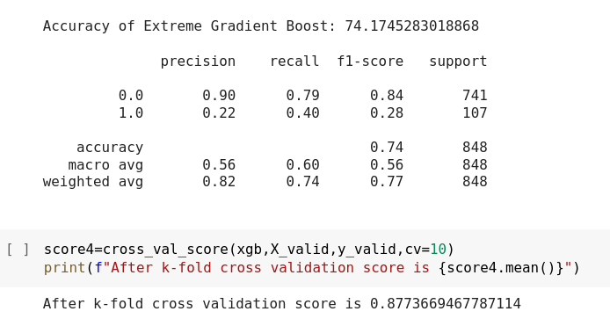
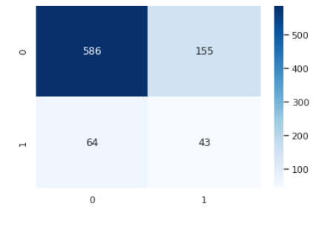
EXTREME GRADIENT BOOST
Confusion Matrix

Slide 18
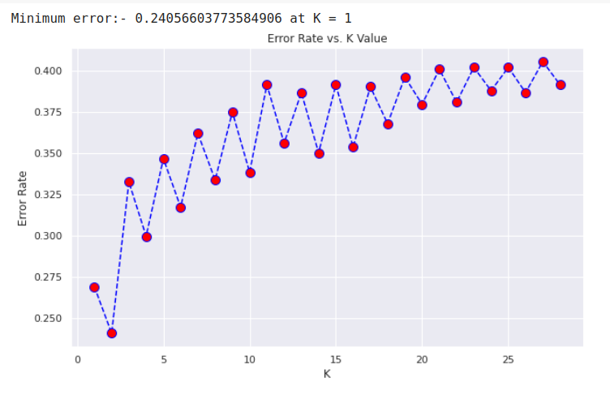
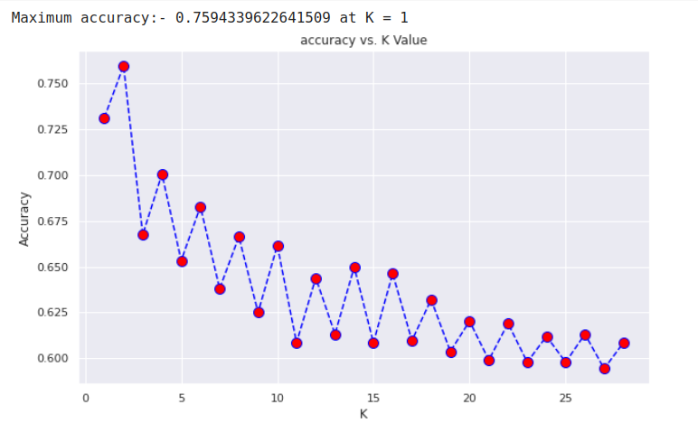
KNEIGHBORS
Error Rate
Accuracy Rate

Slide 19
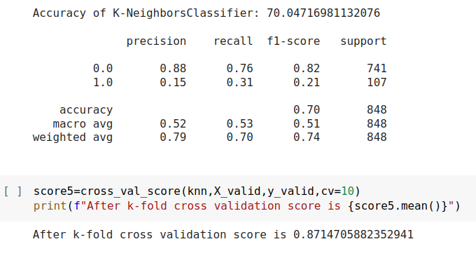
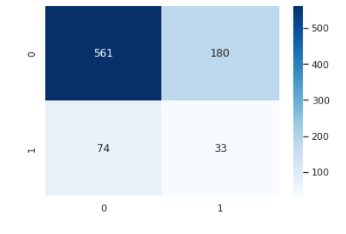
KNEIGHBORS
Confusion Matrix

Slide 20
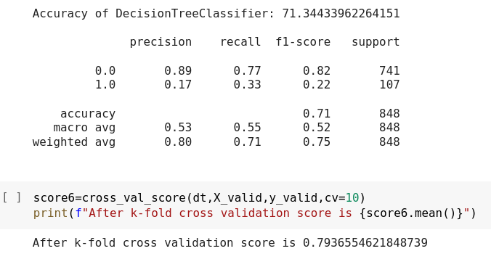
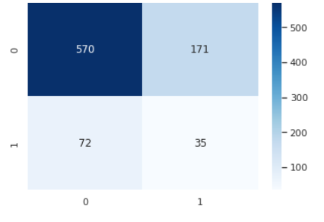
DECISION TREE
Confusion Matrix

Slide 21
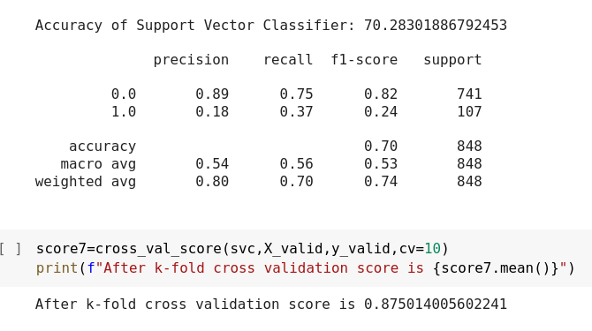

SUPPORT VECTOR CLASSIFIER
Confusion Matrix

Slide 22
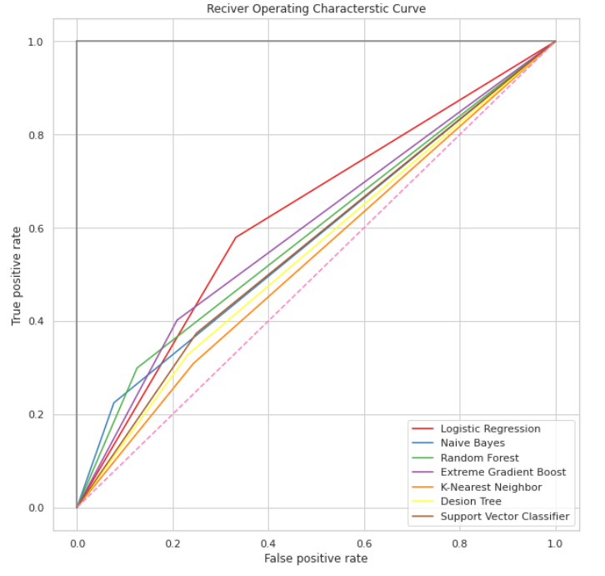
ROC CURVE

Slide 23
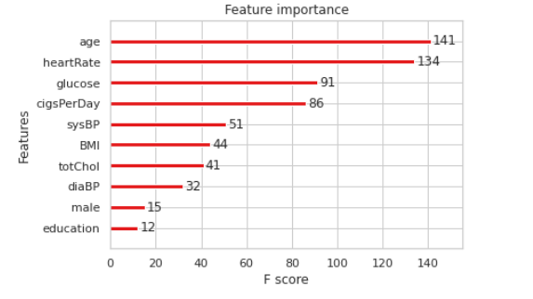
IMPORTANT FEATURES OF EXTREME GRADIENT BOOST CLASSIFIER

Slide 24
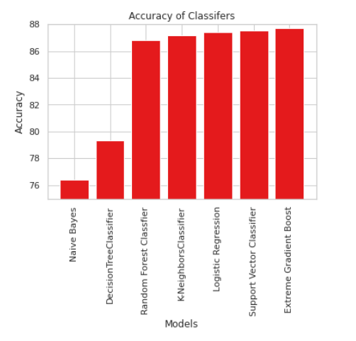
ACCURACY COMPARISON
As we can see,
Extreme Gradient Boost algorithm is most accurate for this dataset.

Slide 25
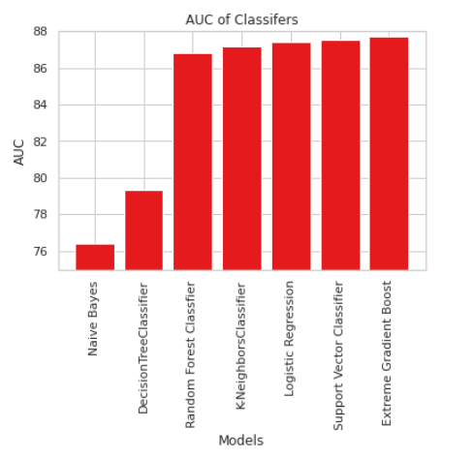
AUC COMPARISON
As we can see,
Extreme Gradient Boost algorithm has most AUC for this dataset.

Slide 26

THANK YOU
Prof. Khashayar Dehnad

